Slide 1
Automated Sprinkler System and Mobile App using IoT
Shariar Hasan
ID: 18701012
Session: 2017-18
Supervised by:
Dr. Muhammad Sanaullah Chowdhury
Department of Computer Science & Engineering
University of Chittagong

Slide 2
Problem Statement
Reduce the overuse of water in gardening
Take decision according to Rain or Humidity
Determine the ability of soil to plant multiple species of plant in a single land

Slide 3
Progress
Methodology
Current Work
Future Target

Slide 4
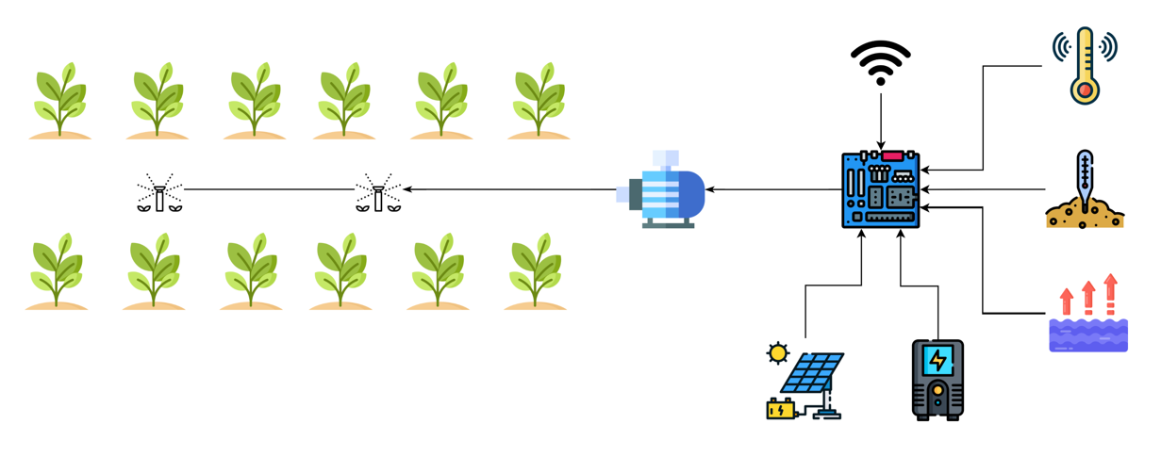
Methodology

Slide 5
Current Work
Working on the circuit of the whole proccess
Building the mobile app

Slide 6
Future Target
Complete the whole circuit
Complete the mobile app

Slide 7

Thank YOU

